Slide 1

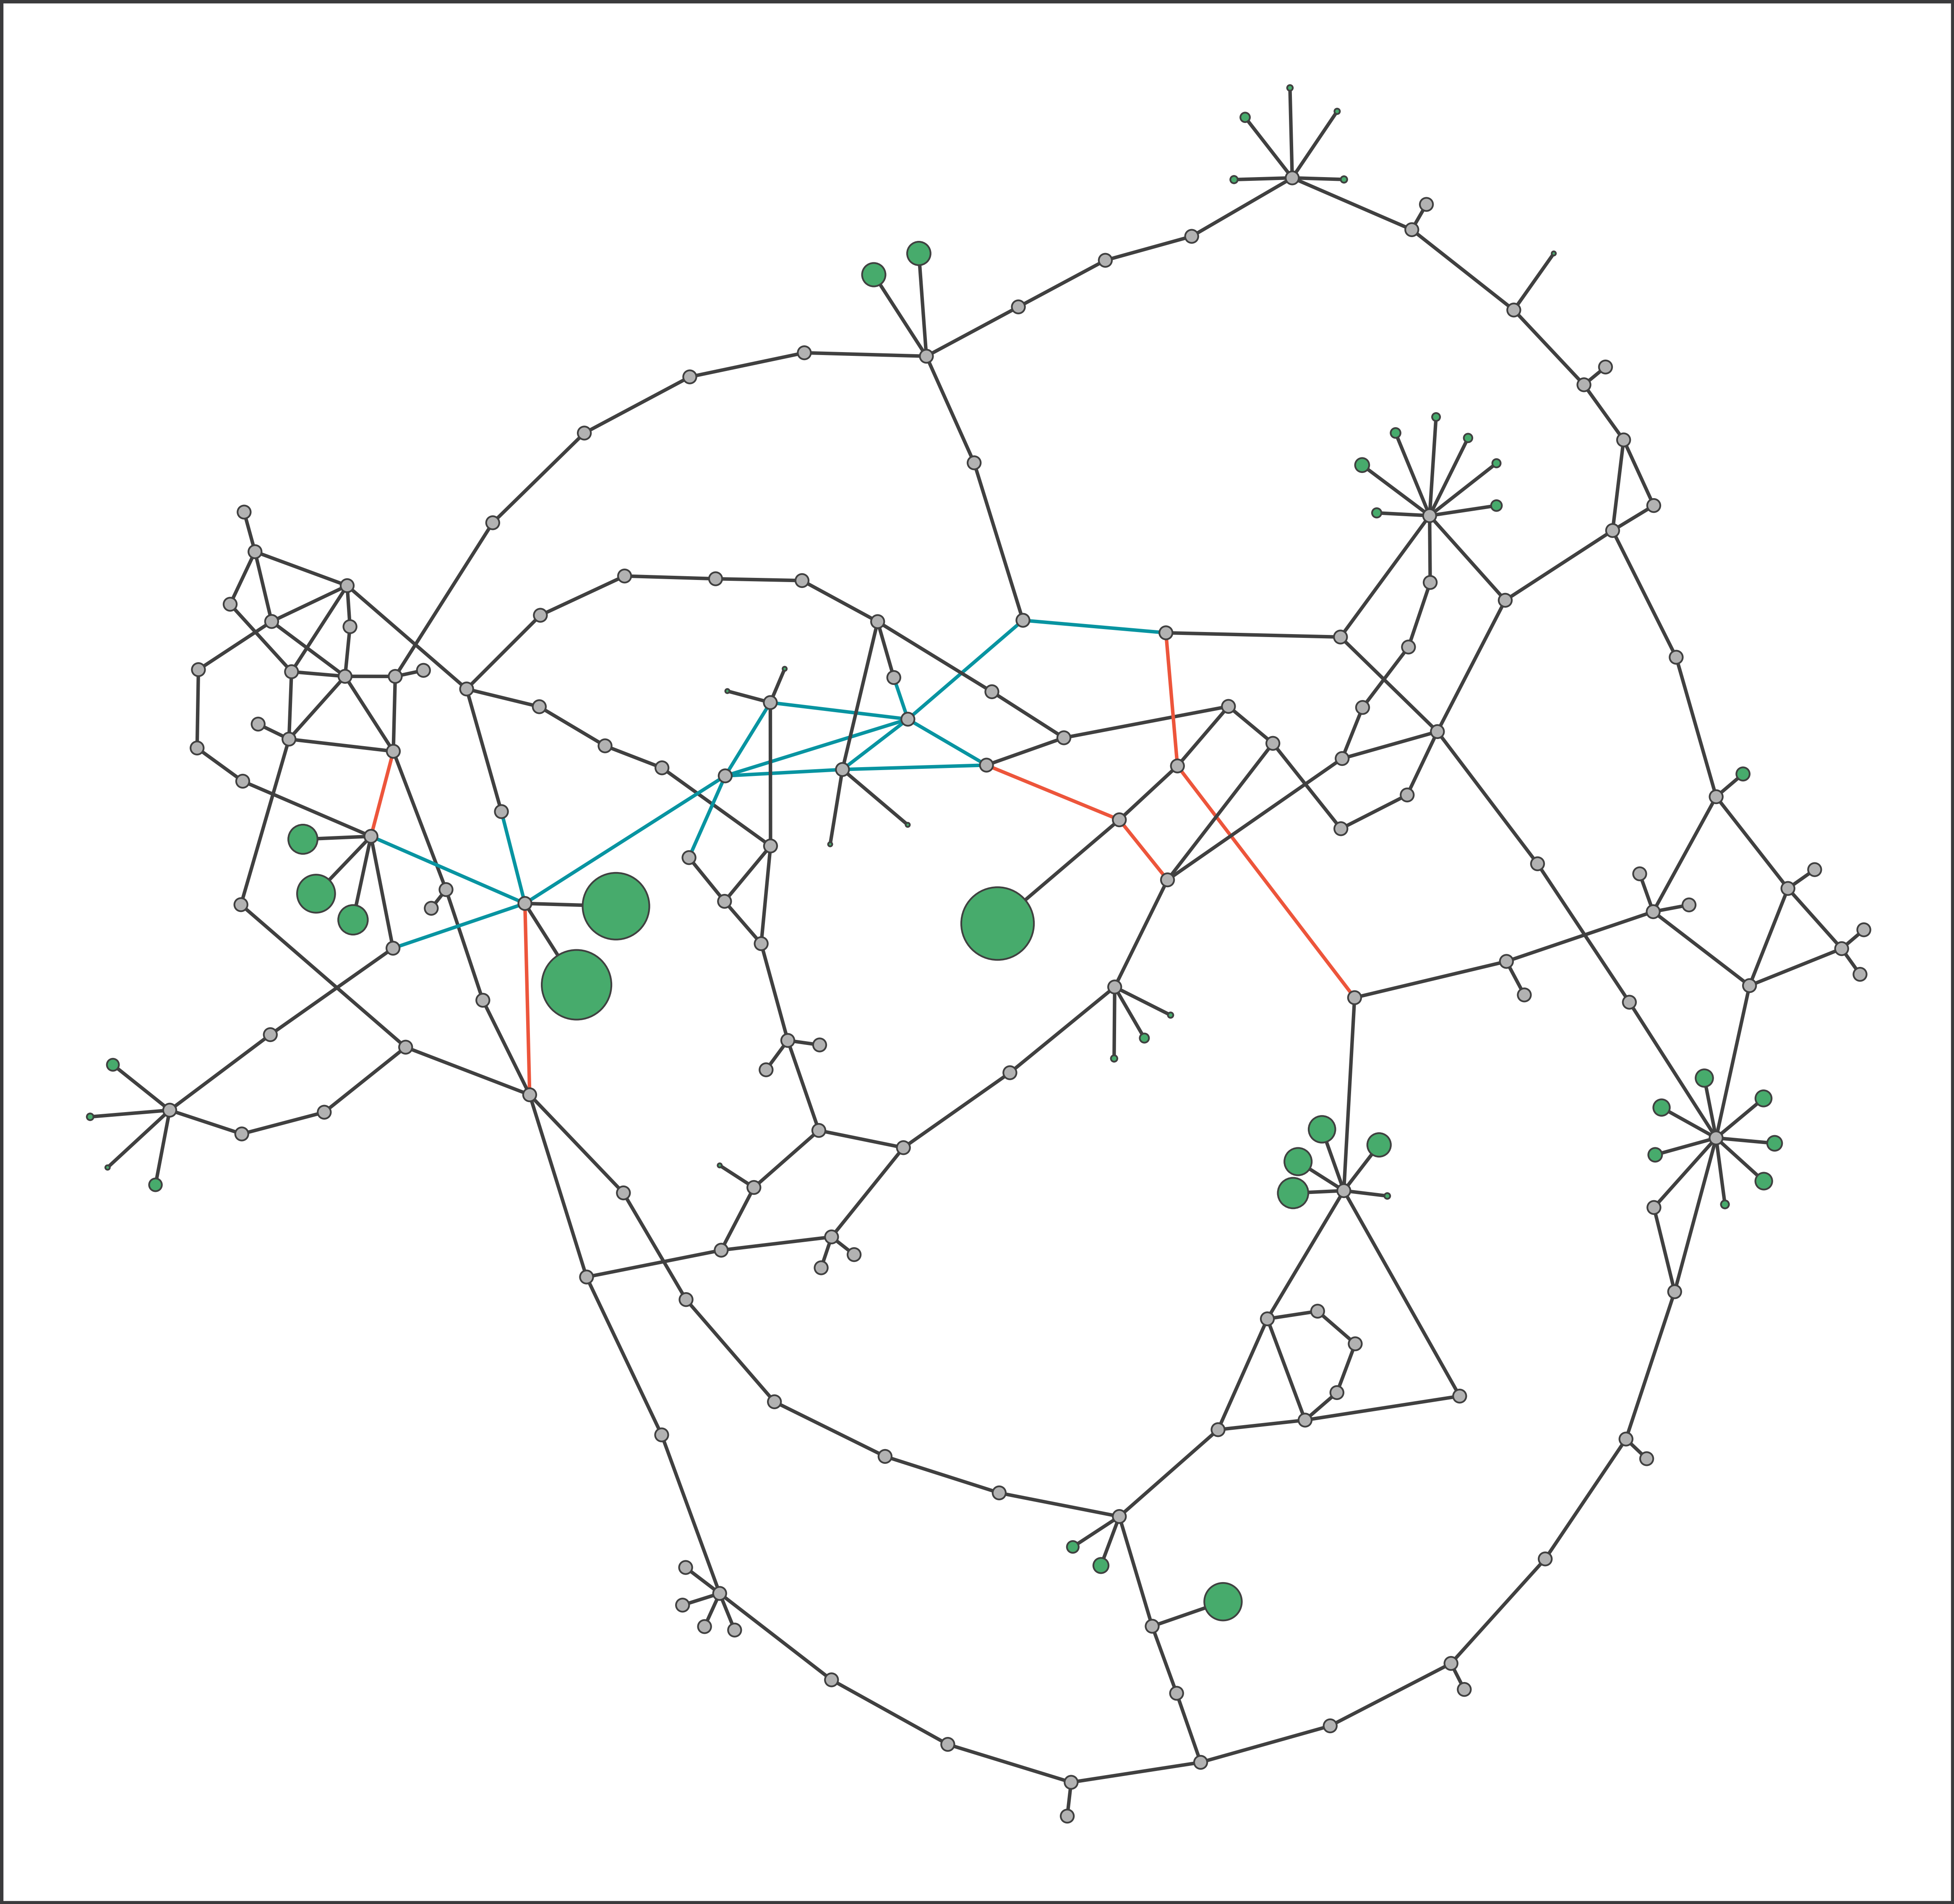
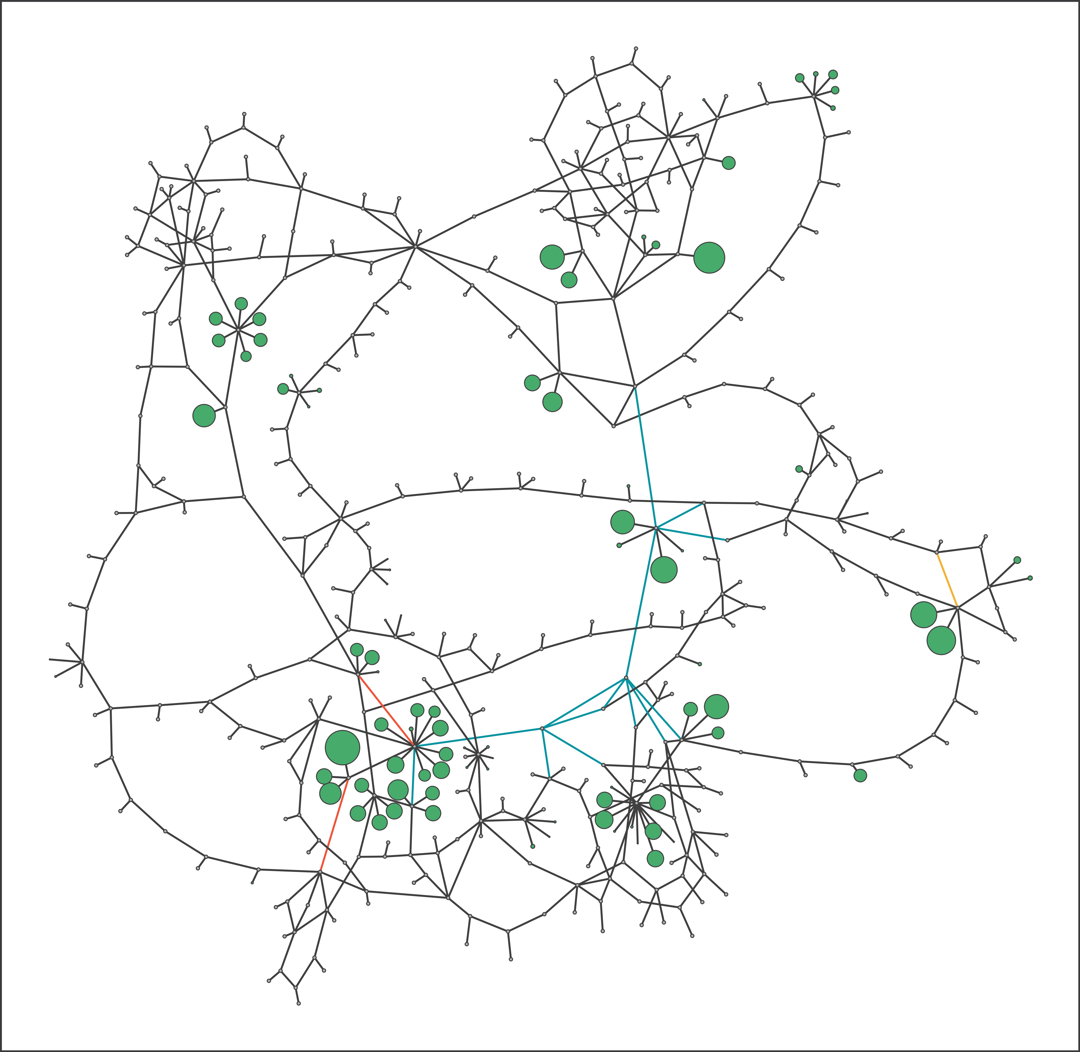
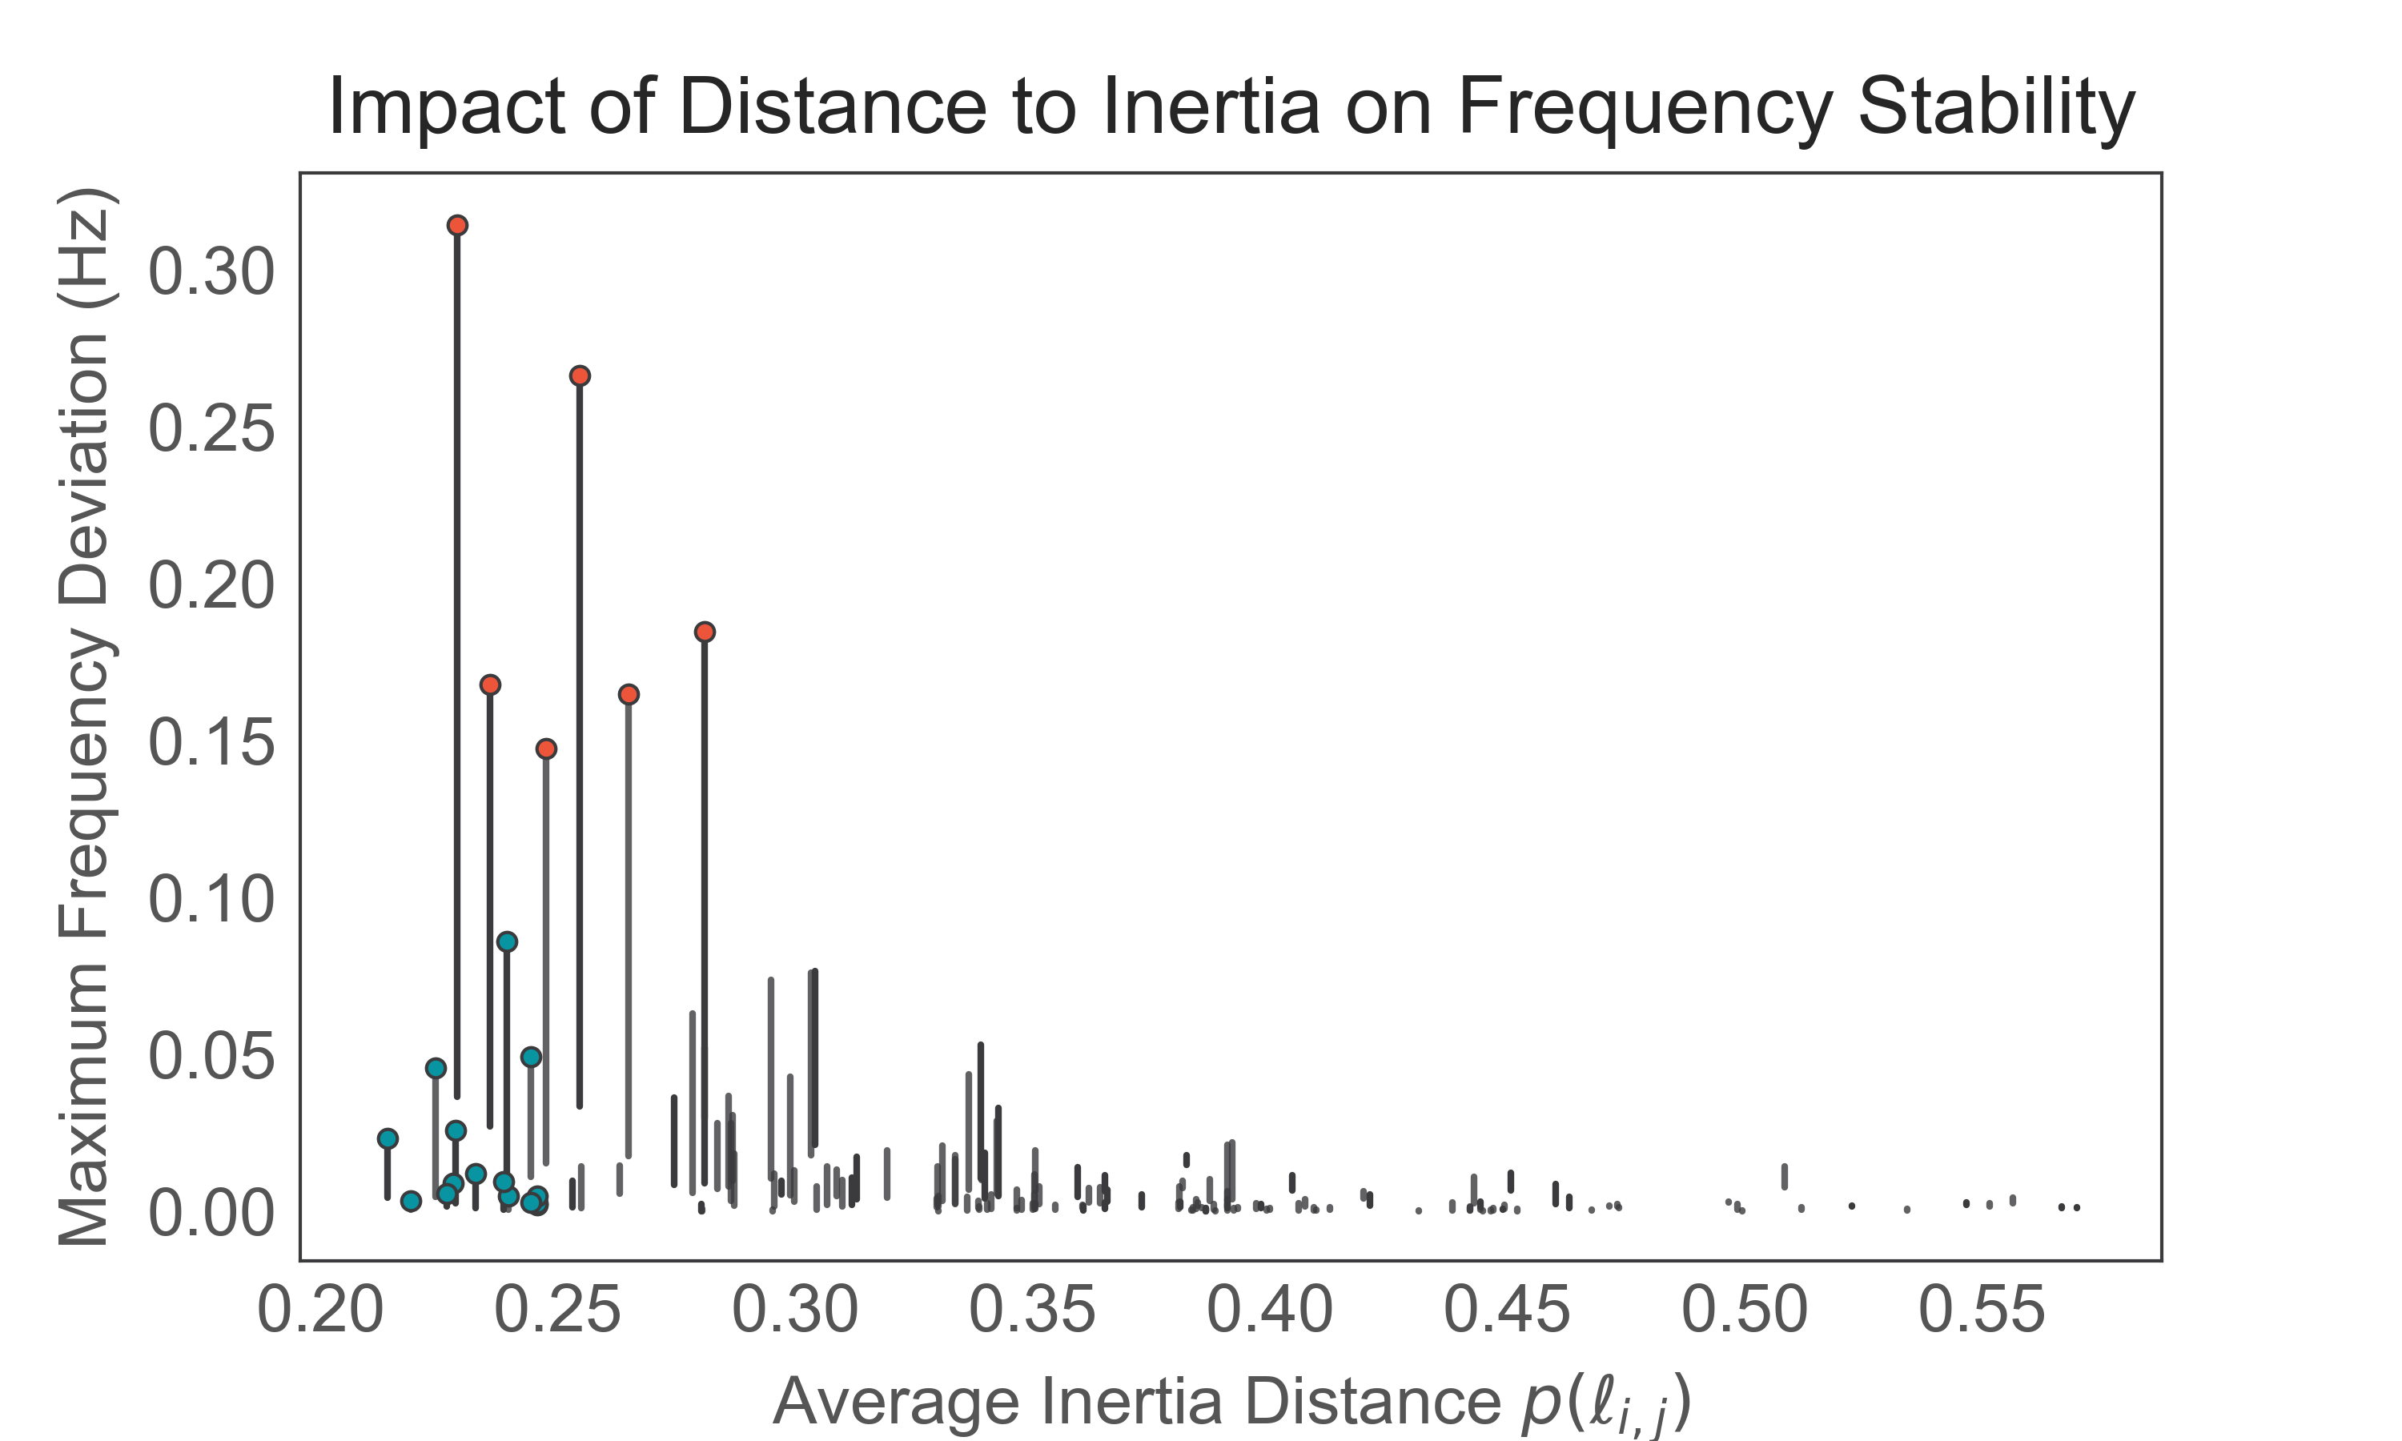
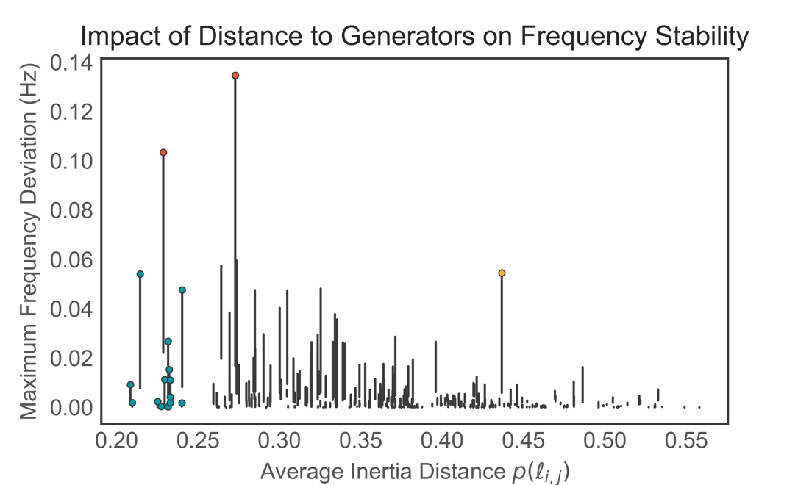
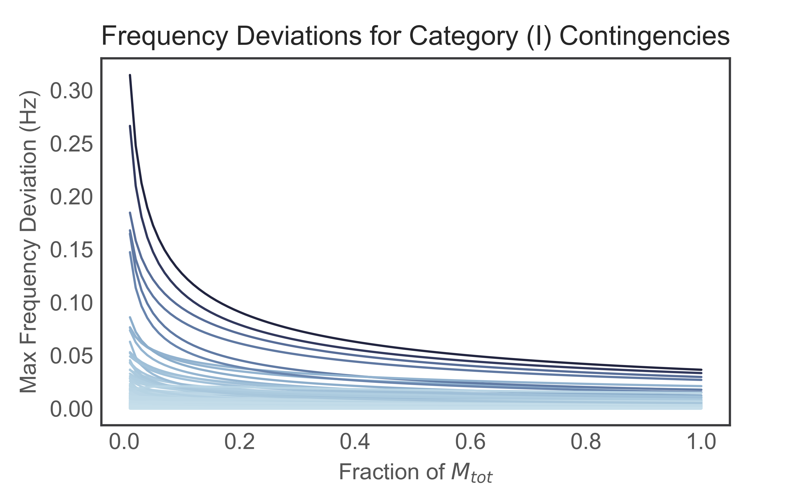
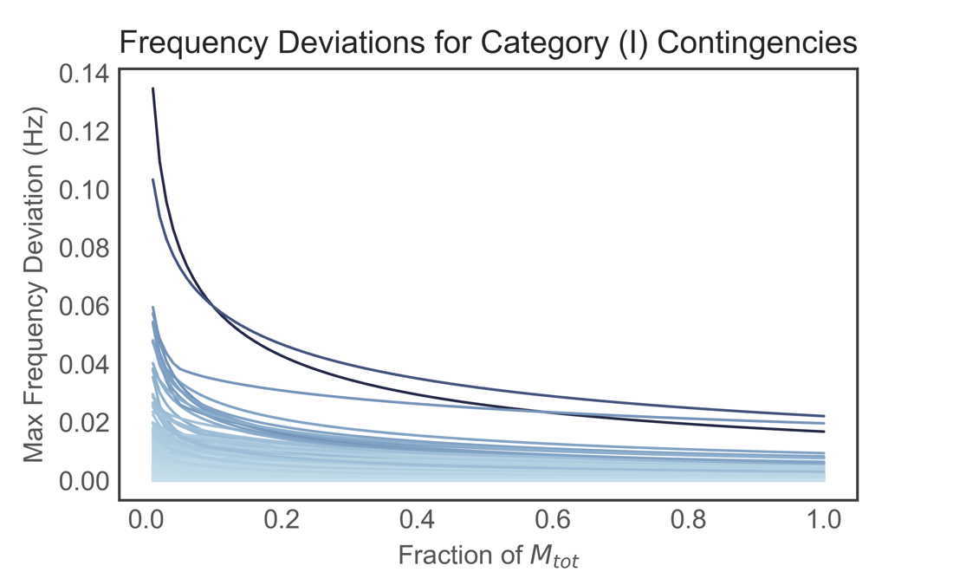
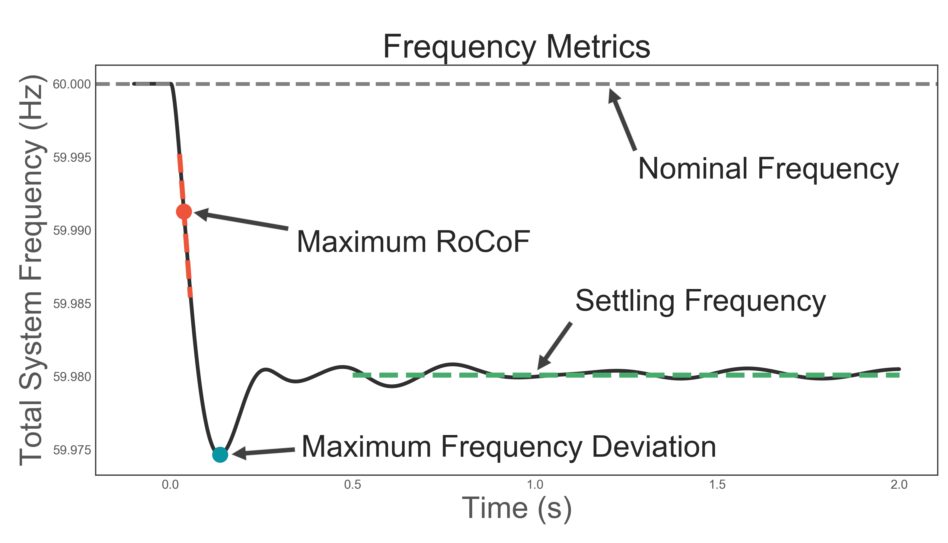
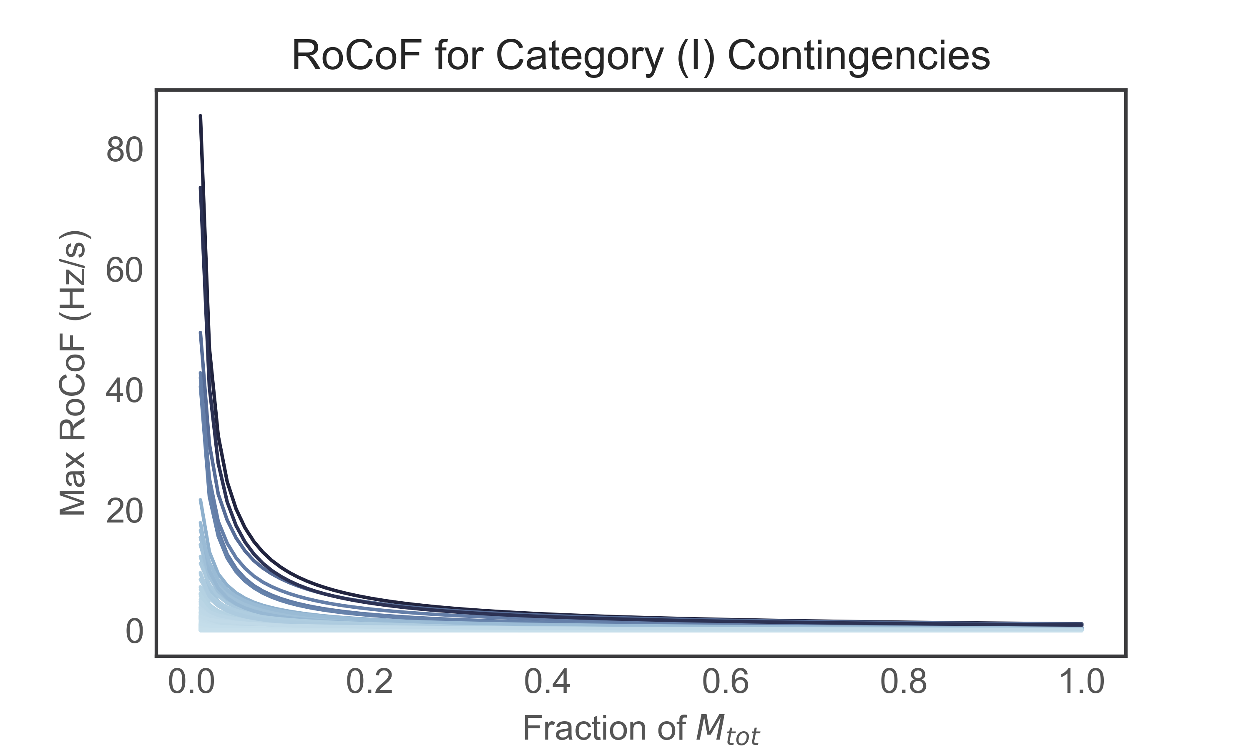
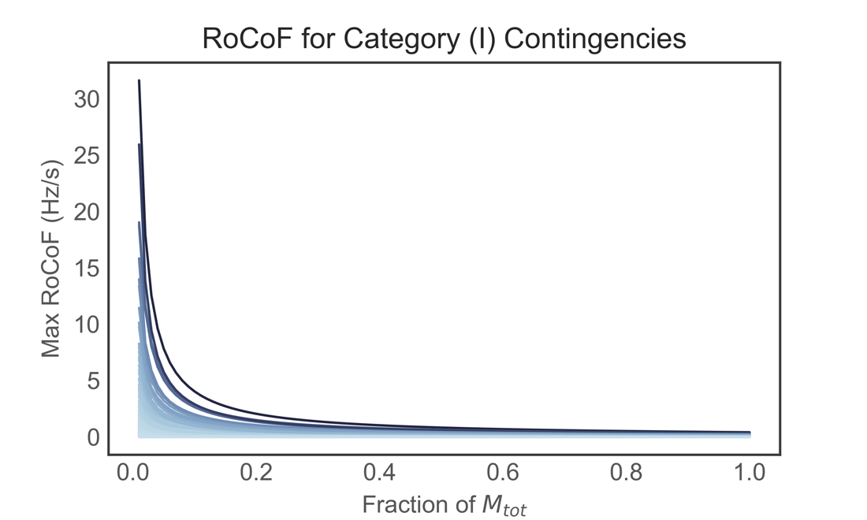
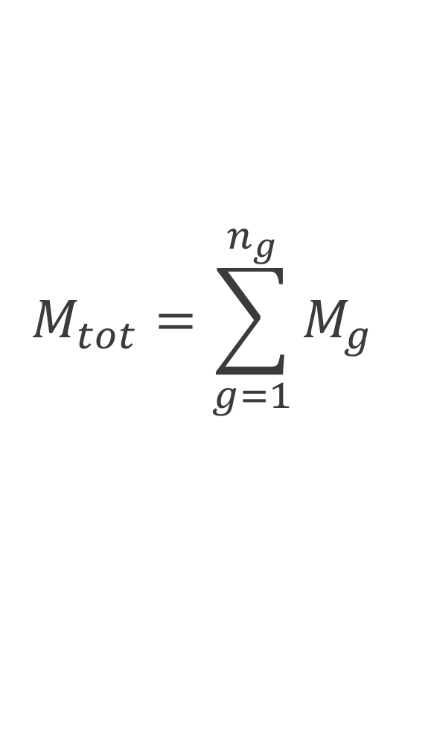
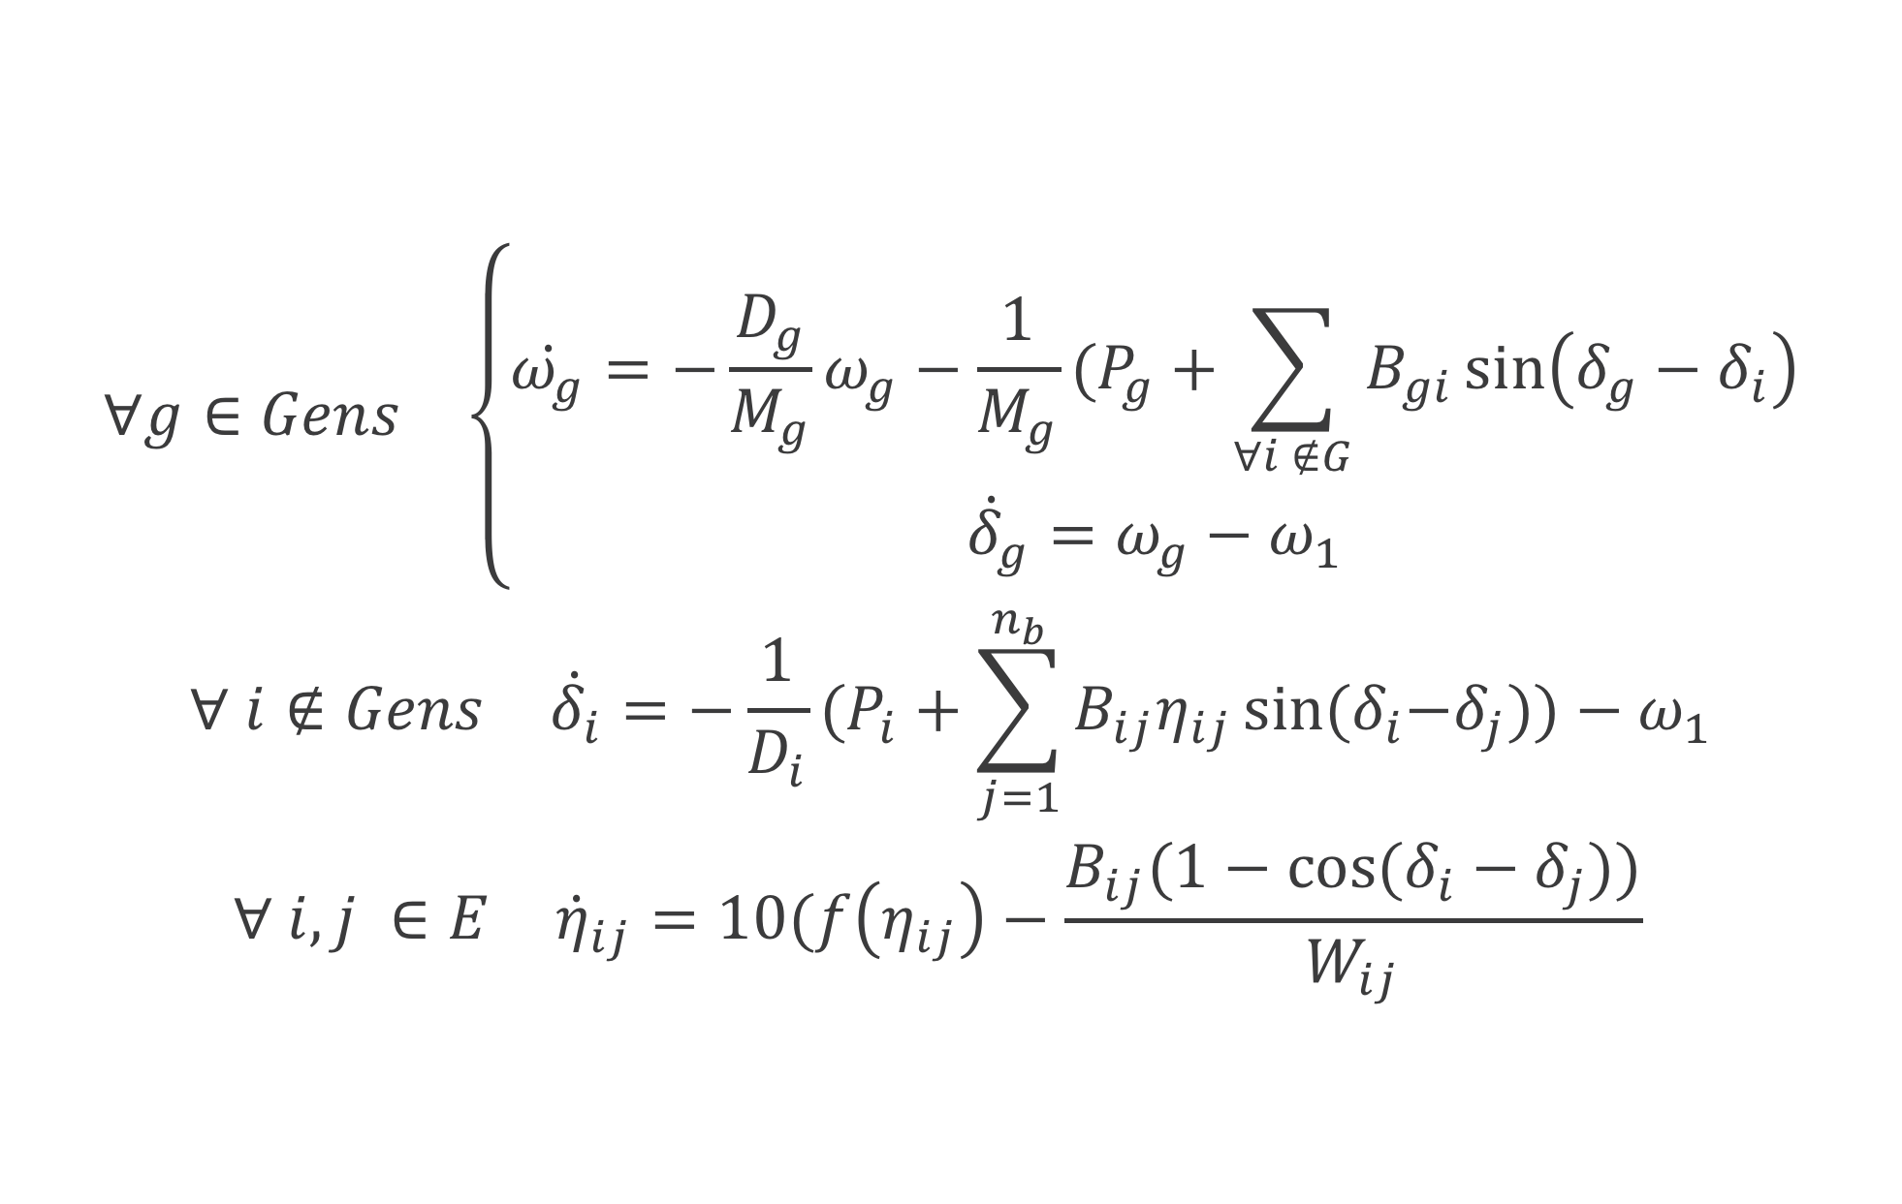
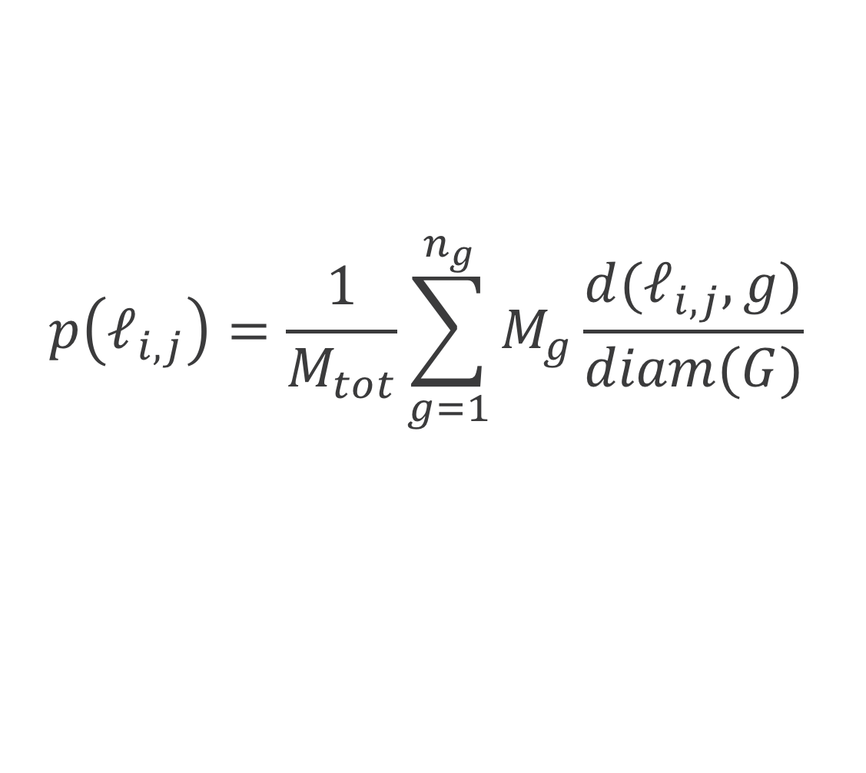

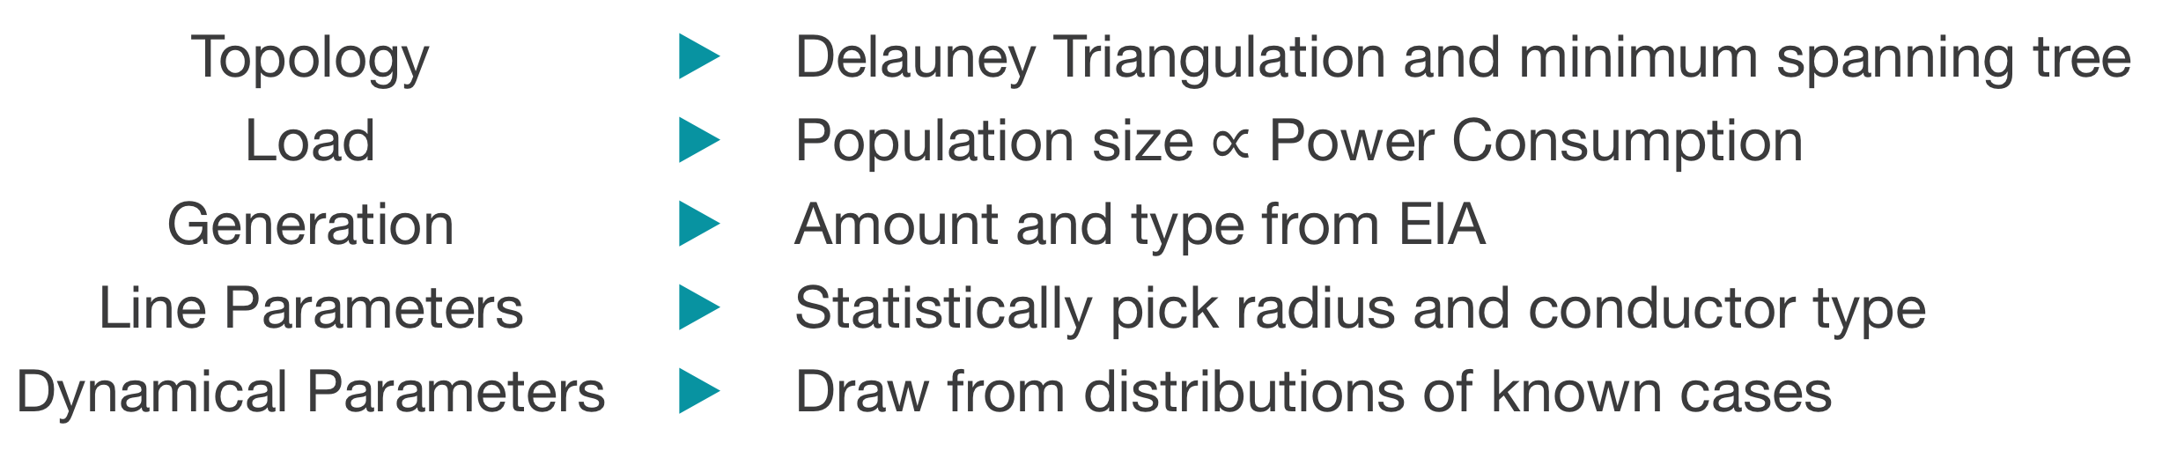
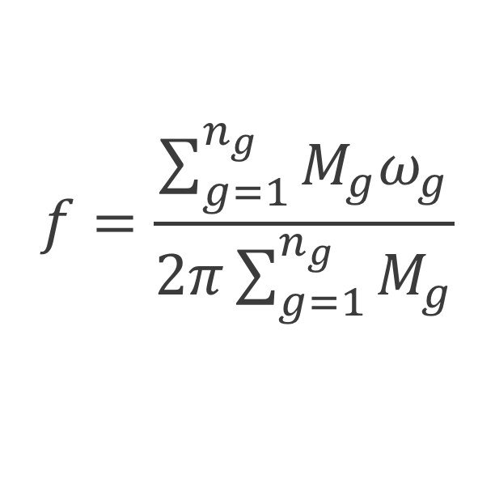
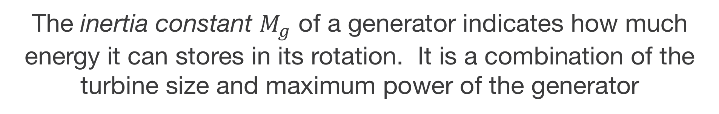
The Role of Inertia in the Cascading-Failure Dynamics of Power Systems
Samantha.Molnar@colorado.edu
Samantha Molnar^{1,2}, Elizabeth Bradley¹, Bri-Mathias Hodge², Kenny Gruchalla²
¹ Department of Computer Science, University of Colorado, Boulder, CO, USA
² National Renewable Energy Lab (NREL), Golden, CO, USA
Overview
Power systems today are undergoing extreme changes with the integration of renewable generation sources such as solar and wind. Traditional generation sources, such as coal and natural gas, provide inertial support, which helps maintain system stability when an outage occurs. However, solar and wind generation do not, on their own, provide this support, which potentially makes the system more vulnerable to failures
Test Cases
Problem:
U.S power grids are considered critical infrastructure → Data is not public
Solution:
Create synthetic networks that statistically match real power grid characteristics
How does total system inertia impact power system stability during cascading failures?
Inertia
Topology | ▶︎ | Delauney Triangulation and minimum spanning tree
Load | ▶︎ | Population size $∝$ Power Consumption
Generation | ▶︎ | Amount and type from EIA
Line Parameters | ▶︎ | Statistically pick radius and conductor type
Dynamical Parameters | ▶︎ | Draw from distributions of known cases
Cascading Failures
The inertia constant $M_{g}$ of a generator indicates how much energy it can stores in its rotation. It is a combination of the turbine size and maximum power of the generator
Generation Type | $M_{g}$ (MW・s)
Nuclear | 5344-6530
Coal | 863-3158
Solar | 0
Total System Inertia
September 21, 2016: A fire at Aguirre Power Station in Puerto Rico causes a cascading failure resulting in an island-wide blackout. Image from [1].
Illinois
South Carolina
$$M_{tot}=\sum_{g=1}^{n_{g}}{M_{g}}$$
Model
$$\begin{matrix}\begin{matrix}∀g∈Gens & \left\{\begin{aligned}\dot{ω_{g}}=−\frac{D_{g}}{M_{g}}ω_{g}−\frac{1}{M_{g}}(P_{g}+\sum_{∀i ∉G}{B_{gi}\sin\left(δ_{g}−δ_{i}\right)} \\ {\dot{δ}}_{g}=ω_{g}−ω_{1}\end{aligned}\right.\end{matrix} \\ \begin{matrix}∀ i∉Gens & {\dot{δ}}_{i}=−\frac{1}{D_{i}}(P_{i}+\sum_{j=1}^{n_{b}}{B_{ij}η_{ij}\sin{{(δ}_{i}−δ_{j}))−ω_{1}}}\end{matrix} \\ \begin{matrix}∀ i,j ∈E & {\dot{η}}_{ij}=10(f\left(η_{ij}\right)−\frac{B_{ij}(1−\cos{(δ_{i}−δ_{j}))}}{W_{ij}} \end{matrix}\end{matrix}$$
Average Inertia Distance
We use the average inertia distance to understand how topology plays a role in frequency stability. Although the
$$p\left(ℓ_{i,j}\right)=\frac{1}{M_{tot}}\sum_{g=1}^{n_{g}}{M_{g}\frac{d(ℓ_{i,j},g)}{diam(G)}}$$
Frequency Stability
We compute the system frequency for each cascading failure simulation to quantify the resulting dynamics. Frequency stability is a growing concern as more renewable generation is added to power systems.
As total system inertia decreases, the maximum frequency deviation and the RoCoF increase. Furthermore, the trend is non-linear.
$$f=\frac{\sum_{g=1}^{n_{g}}{M_{g}ω_{g}}}{2π\sum_{g=1}^{n_{g}}{M_{g}}}$$
In general, contingencies that are closer to large-inertia generation cause a higher frequency deviation. However, there are some exceptions: denoted by a blue point. This indicates a more complicated relationship with network topology.
Conclusions
As total system inertia decreases power system frequency dynamics will increase non-linearly. Furthermore, these dynamics are dependent on the structure of the network, illustrated by the dependence of the maximum frequency deviation on the average inertia distance. However, the structural dependence is not entirely captured by the average inertia distance which suggests that
References
NASA Earth Observatory. Puerto Rico Goes Dark. https://earthobservatory.nasa.gov/images/88796/puerto-rico-goes-dark . Accessed: 3-2-2019.

